Slide 1
From Disc to Result Plans, Scans & Costs
© Mendy Steinmetz

Slide 2
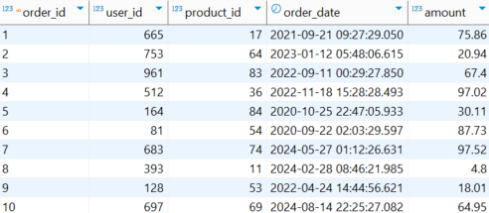
How many orders were made in 2020?

Slide 3
select count(*)
from orders
where order_date >= '2020-01-01'
and order_date < '2021-01-01';
Execution Time: 262 ms
select count(*)
from orders
where Year(order_date) = 2020;
Execution Time: 931 ms

Slide 4


Mendy, BI & Data Developer
Focused on data pipelines and processes, Using Python, Qlik, and SQL to analyze video data. contributing to Qlik open-source efforts

Slide 5
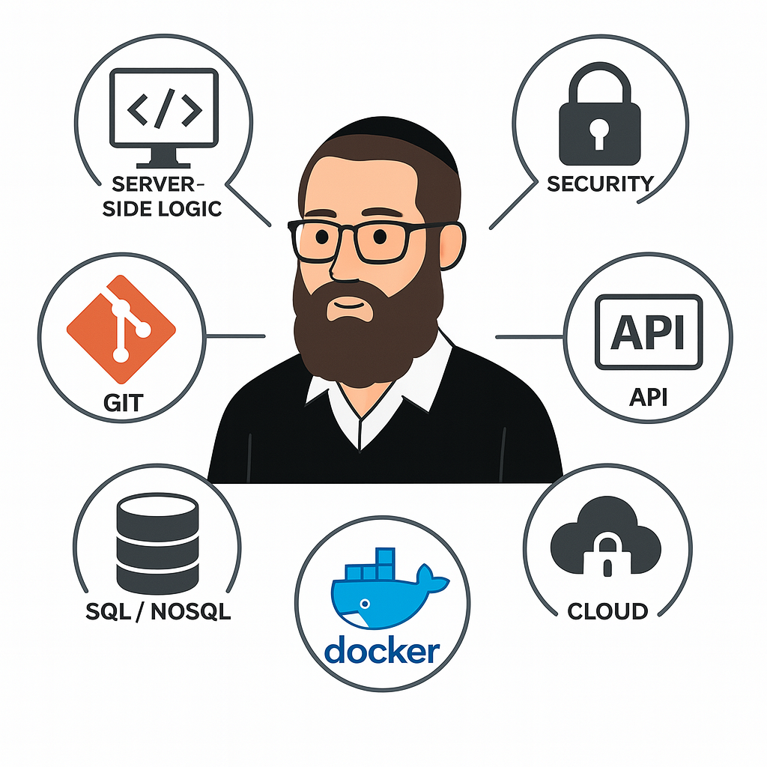
Why should we care about the database?

Slide 6
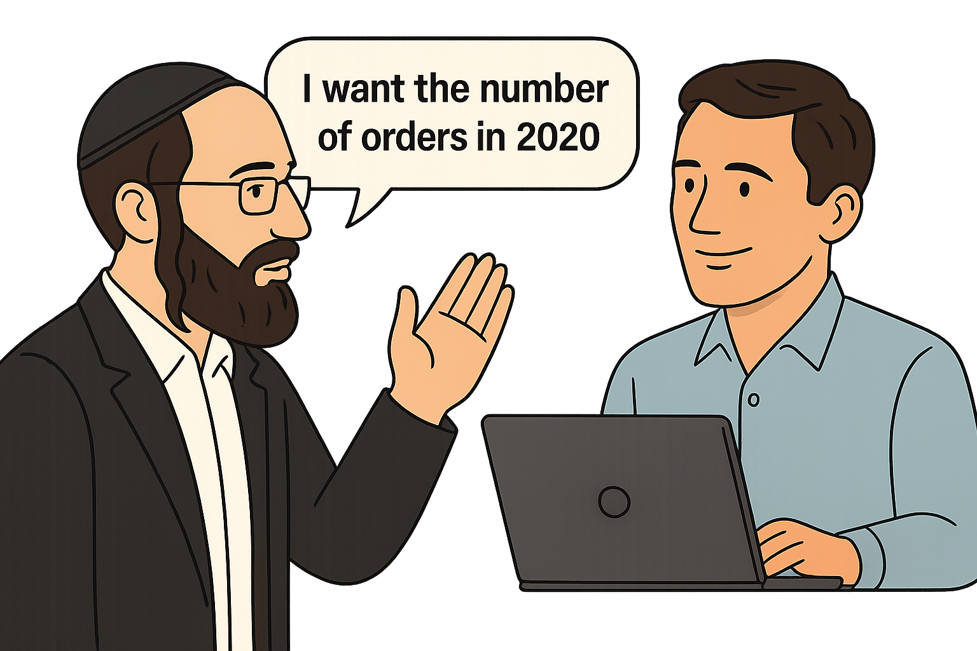
with open(…)
count = 0
for order in orders:
if '2020-01-01' <= order['order_date'] <= '2021-01-01':
count += 1

Slide 7
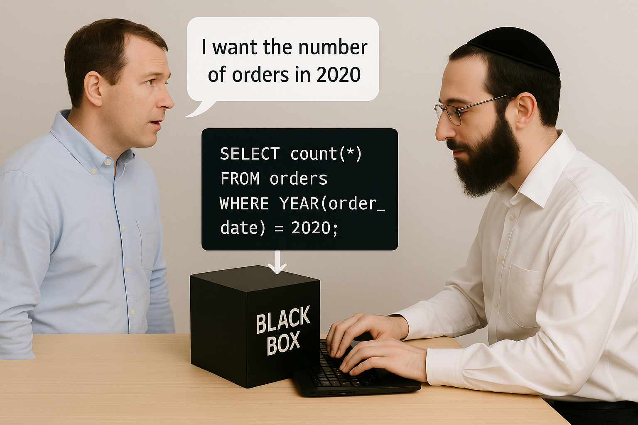
SQL tells what, not how

Slide 8
EXPLAIN
EXPLAIN (ANALYZE, BUFFERS…)
select *
from my_table
where ...
Execution plan
How tables are scanned
Estimates execution costs.

Slide 9
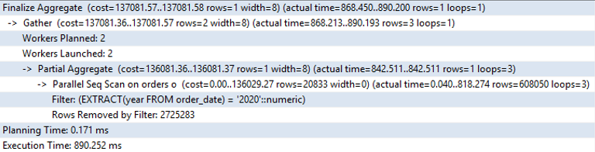
explain analyze
select count(*)
from orders
where Year(order_date) = 2020;

Slide 10
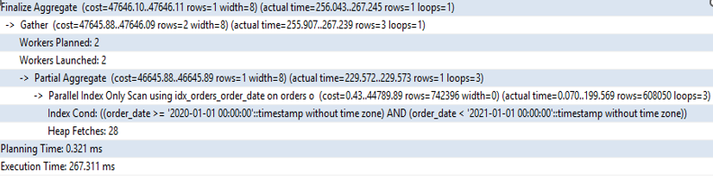
explain analyze
select count(*) from orders
where order_date between '2020-01-01'
and '2021-01-01';

Slide 11
Scans

Slide 12
1. Seq Scan
Used when there’s a need to pull large amounts of data
No Index available
Consistent performance time
Saves time on index building and planning (Ideal for small tables)
4 Types of Scan
for row in TABLE: if row["value"] == target_value: results.append(row)

Slide 13
2. Index Scan
Efficient for retrieving less than 10% of the data
Requires index maintenance
Large table
4 Types of Scan
INDEX = {} for row in TABLE: INDEX.setdefault(row[“value”], []).append(row[“TID”])
if target_value in index: results = index[target_value]

Slide 14
3. Index Only Scan
Retrieves the result directly from the index table
Sometimes need to check if the TID is still alive
Does not support some index types (BRIN, Hash, etc.)
4 Types of Scan
result = index.get(target_value, [])

Slide 15
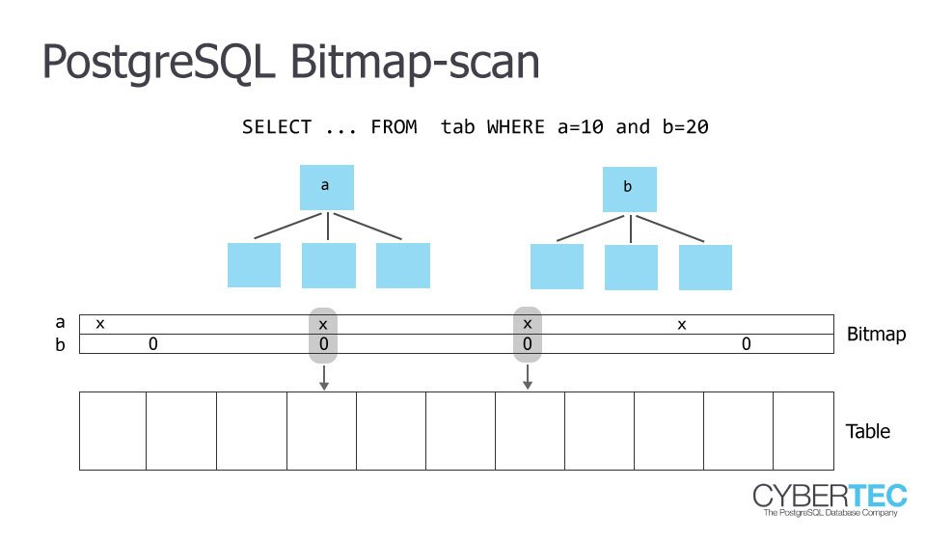
4 Types of Scan
4. Bitmap Index Scan
Used when more data needs to be pulled than a regular index
Multi-condition
Around 20-30%
Requires extra space
Does not support some index types (BRIN, Hash, etc.)

Slide 16
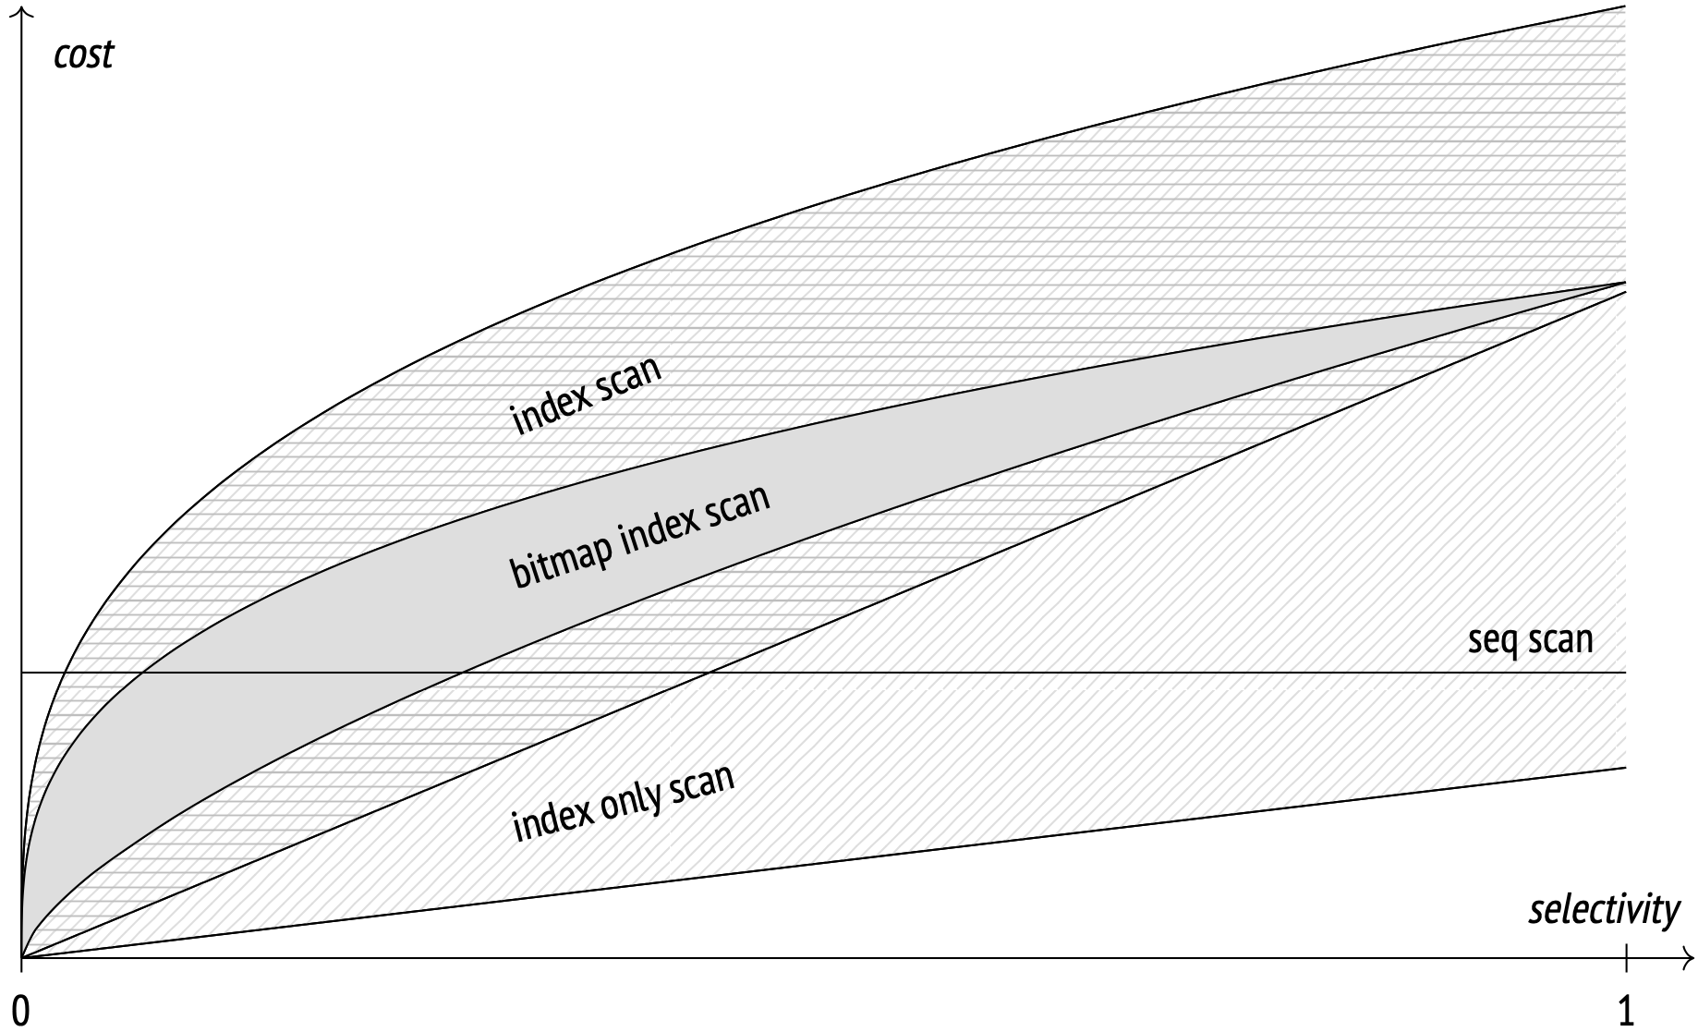
How is a scan type chosen?
Cost

Slide 17
select count(*)
from orders
where Year(order_date) = 2020;

Slide 18
select count(*)
from orders
where order_date >= '2020-01-01'
and order_date < '2021-01-01';

Slide 19

Questions?

Slide 20


Thanks

